Slide 1



BIRZEIT UNIVERSITY
ARABIC MEDICAL SEMANTIC QUALIFIERS
Prepared By :
Hidaya Mustafa
Rana Odeh
Katya Kobari
Supervisor :
Dr.Adnan Yahya
Collaboration with :
Dr.Lujain Alsadder - From Queen Mary University of London.
12 July, 2025

Slide 2


Contents Overview
Introduction
Motivation
Problem Statement
Objectives
System Architecture
Data Collection
Preprocessing Techniques
Feature Extraction
BIO Tagging Strategy
Symptoms and Qualifiers Extraction Model
Testing & Evaluation
Building a Semantic Qualifier Repository
Diagnosis Classification Model
Database Design
Web Application
Future Work
Limitations
Conclusion

Slide 3
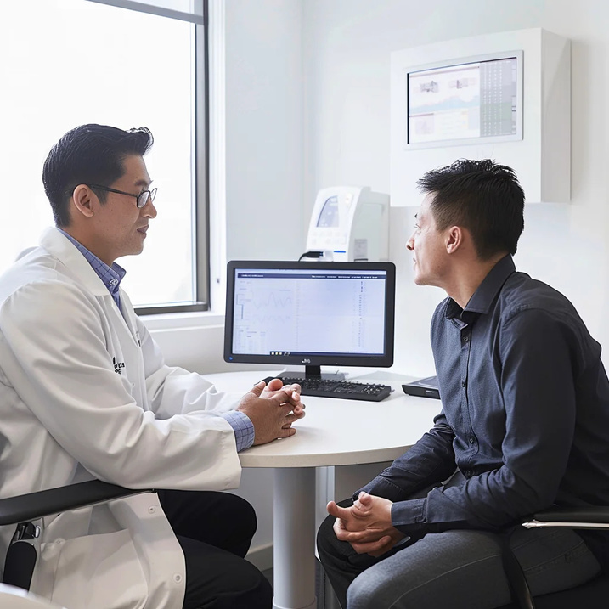


Introduction
Arabic-speaking healthcare systems face a significant gap in structured symptom interpretation due to the absence of standardized semantic qualifiers in Arabic medical communication. This makes it difficult to extract accurate clinical meaning from patient-doctor dialogues.

Slide 4


Motivation
Bridge the linguistic gap in Arabic clinical settings
Build an AI system that understands Arabic medical conversations and predicts the most likely heart-related diagnosis
Help junior doctors and medical students apply textbook knowledge to real-life cases
Standardize symptom expressions in Arabic
Enhance diagnostic accuracy using AI

Slide 5
Problem Statement
ARABIC MEDICAL CONVERSATIONS ARE UNSTRUCTURED AND INFORMAL
PATIENTS OFTEN USE DIALECTAL OR VAGUE LANGUAGE
NO AI TOOL CURRENTLY HANDLES ARABIC MEDICAL DIALOGUE
NO STANDARDIZED ARABIC SYSTEM FOR EXPRESSING SYMPTOMS
DOCTORS ARE TRAINED IN ENGLISH, BUT PATIENTS SPEAK IN ARABIC
THIS GAP LEADS TO MISINTERPRETATION AND DIAGNOSTIC ERRORS

Slide 6

Objectives
Develop an AI system to extract symptoms from Arabic medical dialogues.
Identify key qualifiers: time, location, severity, duration, and spread.
Map extracted data to SNOMED CT medical terms.
Predict the most likely heart-related diagnosis.
Build a bilingual web platform for user interaction.
Bridge the gap between textbook knowledge
and real-world Arabic cases.

Slide 7
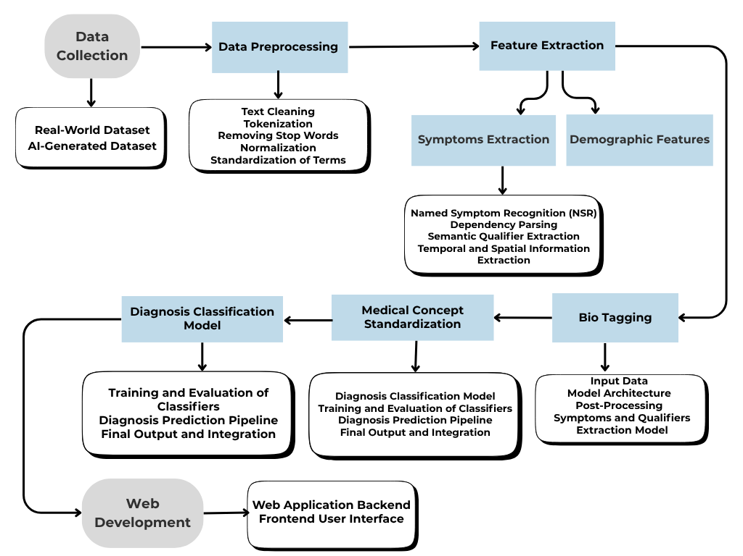
System Architecture Overview

Slide 8
Data Collection
Real-world Dialogues: Medical conversations sourced directly from hospitals, providing authentic scenarios.
AI-Generated Dialogues: Simulated medical conversations to fill gaps in real-world data and cover rare or diverse cases.

Slide 9
Sample Dialogue
الجنس: ذكر
العمر: 45 عامًا
التاريخ المرضي:ارتفاع ضغط الدم.
الطبيب: مرحبًا، أنا الدكتور أحمد، كيف أستطيع مساعدتك اليوم؟
المريض: مرحبًا دكتور، أشعر بألم في صدري منذ فترة. إنه شعور مزعج جدًا، ولا أستطيع تحديد السبب.
الطبيب: أنا آسف لسماع ذلك. هل يمكنك أن تصف لي هذا الألم بمزيد من التفصيل؟ هل هو حاد أم خفيف؟ وهل يأتي بشكل متقطع أم دائم؟
المريض: الألم حاد، كأنه ضغط على صدري، ويأتي بشكل متقطع. في بعض الأحيان أشعر به طوال اليوم، لكن في أوقات أخرى يختفي تمامًا.
الطبيب: ومنذ متى وأنت تعاني من هذا الألم؟
المريض: بدأ منذ حوالي أسبوعين، لكنه ازداد في اليومين الأخيرين. في البداية كان مجرد إزعاج، لكن الآن أشعر به بشكل واضح.
الطبيب: هل ينتشر الألم إلى مناطق أخرى في جسمك؟ على سبيل المثال، هل تشعر به في ذراعيك أو رقبتك؟
المريض: نعم، أشعر به يمتد إلى ذراعي الأيسر، وهذا يثير قلقي. أحيانًا أشعر وكأنني فقدت السيطرة على ذراعي.
الطبيب: هل يزداد الألم عند القيام بأي نشاط بدني؟
المريض: نعم، عندما أمشي أو أصعد الدرج يصبح الألم أسوأ. في بعض الأحيان، أشعر بضيق في التنفس أيضًا.
الطبيب: هل تشعر بضيق في التنفس؟ هل هناك أوقات تلاحظ فيها هذا الأمر؟
المريض: نعم، أحيانًا يصعب عليّ التنفس مع الألم، وخاصة في الليل عندما أستلقى.
الطبيب: هل تشعر بخفقان في قلبك أو أي شعور آخر غير معتاد؟
المريض: نعم، في بعض الأحيان أشعر أن قلبي ينبض بسرعة. إنه شعور غريب.

Slide 10
Preprocessing Techniques
Tokenization.
“aubmindlab/bert-base-arabertv02 model”
Original: "أشعر بخفقان حاد و غثيان شديد بعد صعود الدرج."
Tokenized: ['أشعر', 'بخ', '##فقا', '##ن', 'حاد', 'و', 'غ', '##ثيان', 'شديد', 'بعد', 'صعود', 'الدرج', '.']
Normalization.
Original : "ألم في الّصدر"
Normalized : "ألم في صدر"
Remove stop words.
Original: "المريض يشعر بألم في صدره"
After Removal: "المريض يشعر بألم صدره"
Standardization of terms.
Original: ," تسارع نبضات قلبي"""قلبي ينبض بسرعة
Standardized: "خفقان"

Slide 11

Feature Extraction
Feature extraction is a critical step in transforming raw medical dialogues into structured and analyzable data. It focuses on identifying and extracting essential medical information.
SYMPTOM AND QUALIFIERS
Demographic Features

Slide 12
Symptom and Qualifier Extraction
The system extracts both the main symptom and its related semantic qualifiers from Arabic doctor-patient dialogues
Qualifiers include: location, severity, time, duration, and spread to other areas
Extraction is performed using rule-based methods customized for Arabic clinical expressions
Dependency parsing is applied to connect each symptom to its appropriate qualifiers
This process enables a deeper understanding of what the patient feels, where it occurs, how severe it is, and when it started
Example:
"أشعر بألم حاد في صدري يمتد إلى ذراعي"
→ المستخرج : العرض: ألم | الحدة: حاد | المكان: الصدر | الانتشار: الذراع

Slide 13
Demographic Feature
The system extracts basic demographic information from patient dialogues.
This includes: age, gender, smoking status, personal and family medical
history.
Extraction is performed using rule-based patterns tailored to Arabic language.
These features are not used in diagnosis prediction but are stored for
potential future use and analysis.

Slide 14
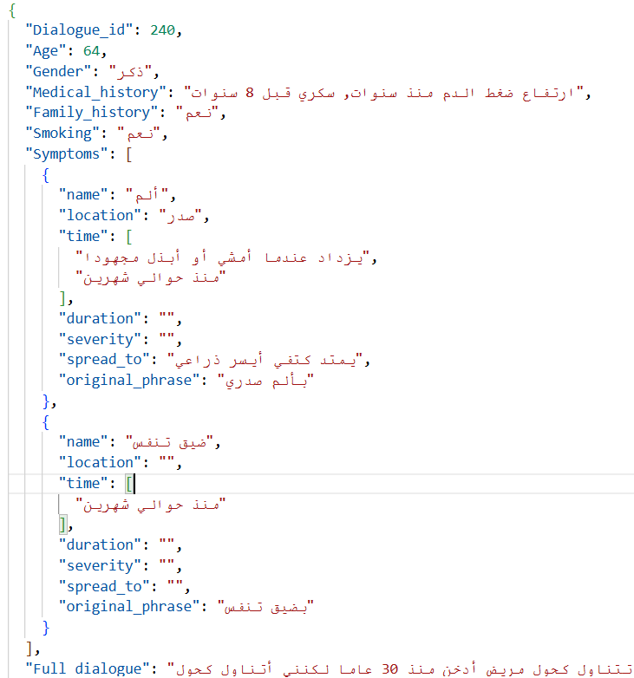
Feature Extraction Output

Slide 15
BIO Tagging Strategy
We applied the BIO tagging scheme to label medical entities within patient responses
Each token is tagged as:
B (Beginning) – the start of an entity
I (Inside) – continuation of the same entity
O (Outside) – not part of any entity
Tags are assigned for: symptoms, time, severity, location, duration, and spread
This structured format prepares the data for training the entity recognition model

Slide 16
BIO Tagging Example
Sample :
لدي ألم في صدري عند الإستقاء يمتد إلى كتفي الأيسر مصحوب بضيق تنفس وأعاني من تعرق شديد
Sample Output :
لدي O
ألم B-SYMPTOM
صدري B-LOCATION
عند B-TIME
إستقاء I-TIME
يمتد B-SPREAD
كتفي I-SPREAD
الأيسر I-SPREAD
مصحوب O
بضيق B-SYMPTOM
تنفس I-SYMPTOM
أعاني O
تعرق B-SYMPTOM
شديد B-SEVERITY

Slide 17

Symptoms and Qualifiers Extraction Model
Testing & Evaluation
Analysis and Interpretation Between BiLSTM + CRF and AraBERT + BiLSTM + CRF models
Metric | BiLSTM + CRF | AraBERT + BiLSTM + CRF
Training Accuracy (Final) | 95.17% | 98.6%
Training Loss (Final) | 17.81 | 4.7
Training Time (sec) | 354.76 | 542.14
Validation Accuracy | 95.09% | 95.54%
Test Accuracy (Token-level) | 85.81% | 89.33%
Test Precision (seqeval) | 65.79% | 71.66%
Test Recall (seqeval) | 57.96% | 72.25%
Test F1-Score (seqeval) | 61.63% | 71.95%

Slide 18
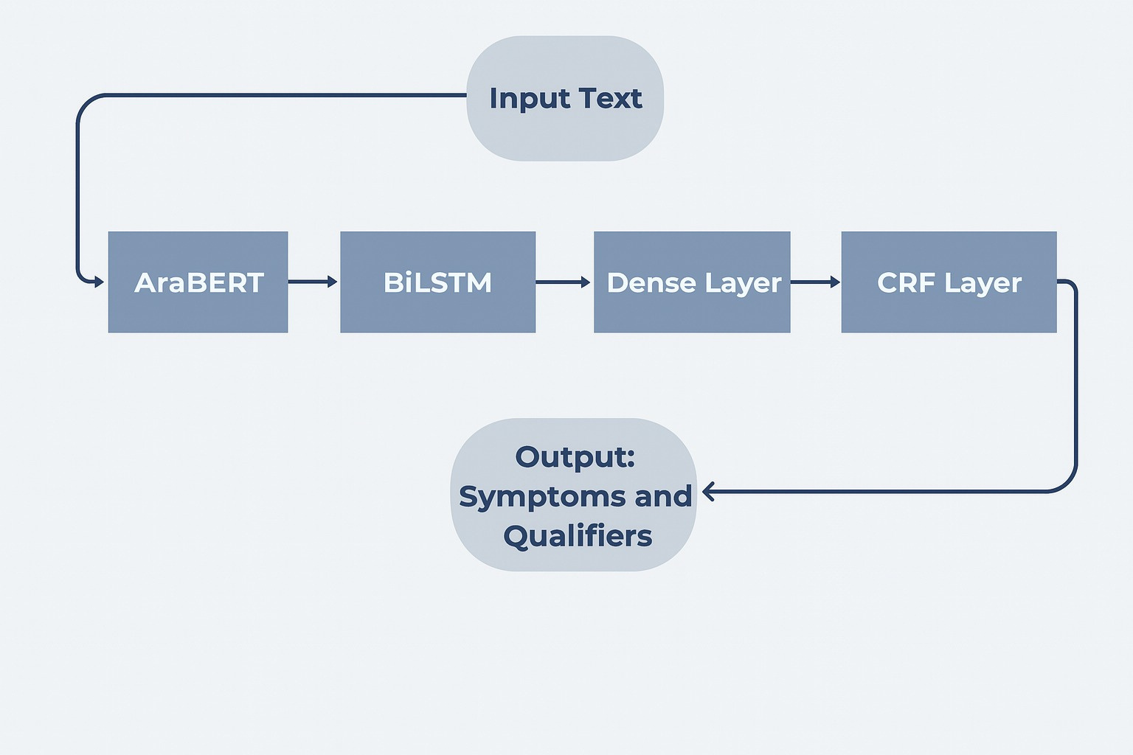
Model Architecture

Slide 19
Testing & Evaluation
Analysis and Interpretation Between Real and AI data
Metric | AI Data | Real Data
Training Accuracy (Final) | 98%+ | 98.7%
Training Loss (Final) | ~5 | ~6
Training Time (sec) | 542.14 | 564.35
Validation Accuracy | 95.54% | 92%
Test Accuracy (Token-level) | 89.33% | 87.89%
Test Precision (seqeval) | 71.66% | 61.54%
Test Recall (seqeval) | 72.25% | 62.51%
Test F1-Score (seqeval) | 71.95% | 62.02%

Slide 20
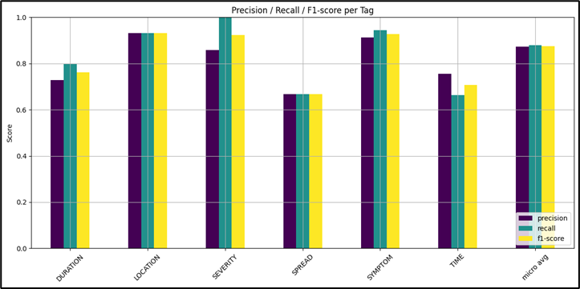
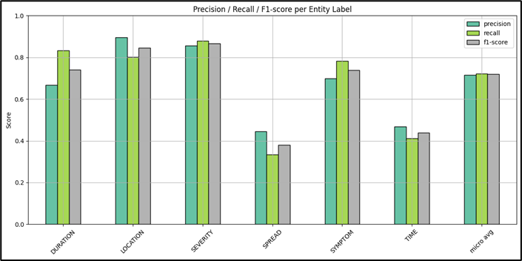
Testing & Evaluation
AraBERT + BiLSTM + CRF Model
For AI Data
Validation
Testing

Slide 21
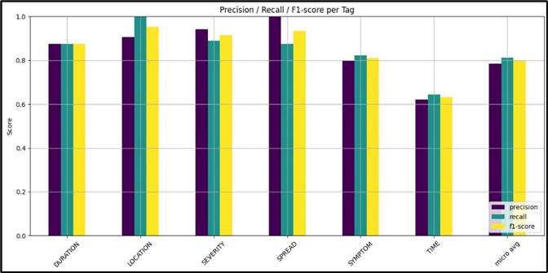
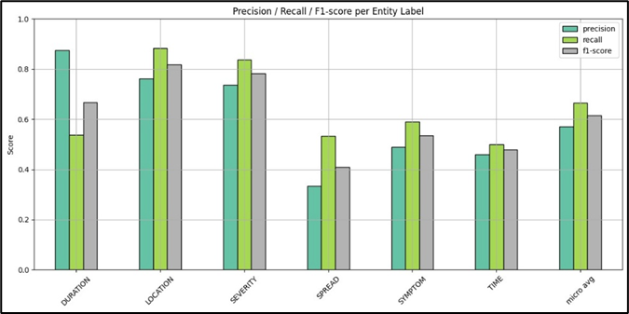
Testing & Evaluation
AraBERT + BiLSTM + CRF Model
For Real Data
Validation
Testing

Slide 22
Building a Semantic Qualifier Repository
Reconstructed subword tokens into full words.
Removed non-entity tokens (O labels).
Extracted full medical entities and their qualifiers.
Merged duplicate symptom mentions within each dialogue.
Preserved the most complete set of attributes per symptom.
Generated structured JSON output with:
symptom name, original phrase, location, time, severity, duration, spread.

Slide 23
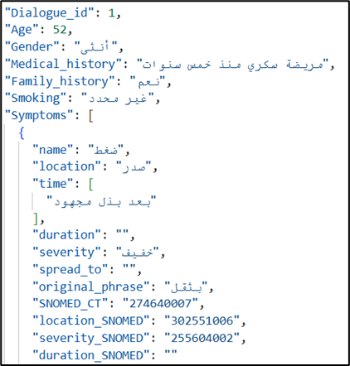
SNOMED CT Mapping
Extracted symptoms and their qualifiers (such as location, severity, duration) are mapped to SNOMED CT, the global standard for medical terminology.
This process ensures that expressions in Arabic are converted into standardized medical concepts.
Arabic phrases are linked to their corresponding English SNOMED terms and codes using a lookup dictionary.
The result is a structured and interoperable format ready for medical analysis or system integration.

Slide 24
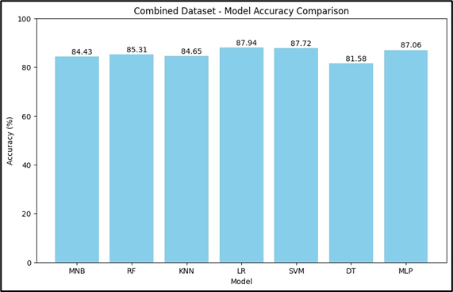
Diagnosis Classification Model
An existing pre-trained diagnosis model was fine-tuned using a cardiac-specific dataset to specialize it for heart condition prediction.
After evaluating seven classifiers, Logistic Regression achieved the highest accuracy (87.94%) and was selected for deployment.

Slide 25
Diagnosis Classification Model
Extracted symptoms were normalized and mapped from Arabic to standardized English terms.
Mapped symptoms were converted into a binary input vector indicating presence/absence.
The input vector was fed into the classifier to generate a diagnosis prediction and confidence score.
Final output includes:
List of mapped symptoms
Predicted diagnosis (English + Arabic)
Confidence percentage
Results are saved in structured JSON format and displayed via the web interface

Slide 26
Database Design
NoSQL-based design for flexibility in handling unstructured data.
Raw Text
Patient-doctor conversations as TEXT FILE.
Processed Data
Extracted symptoms and qualifiers as JSON FILE.

Slide 27
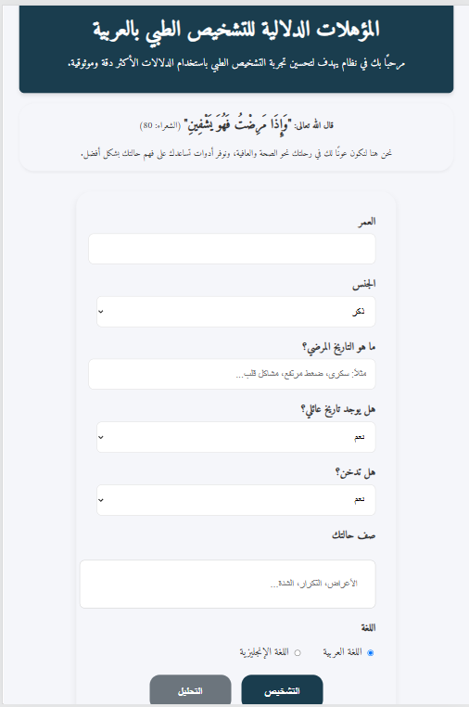
Web Application
Frontend
Developed with HTML, CSS, JavaScript.
Users enter personal data and symptoms in free text.

Slide 28

Web Application
Backend
Built using Flask (Python)
Handles user input: age, gender, symptoms, history
Runs full AI pipeline
Supports Arabic and English output
Returns structured medical results via API

Slide 29
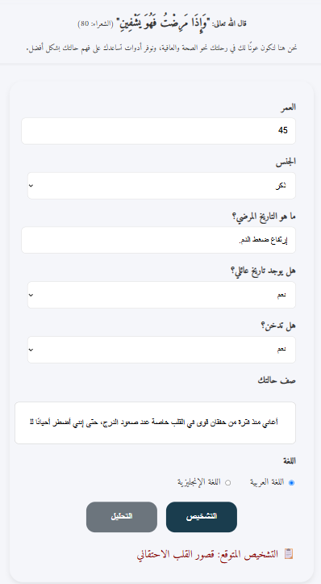
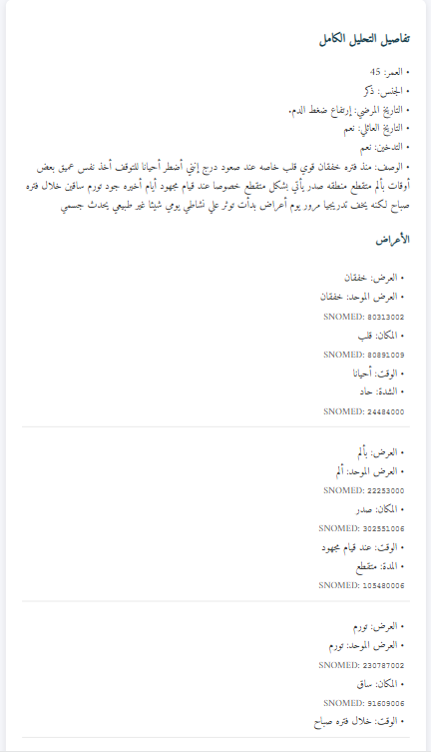
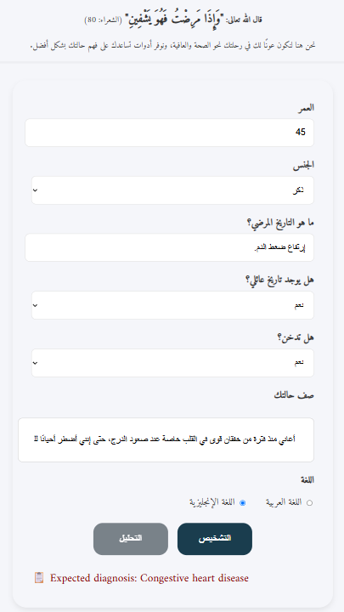
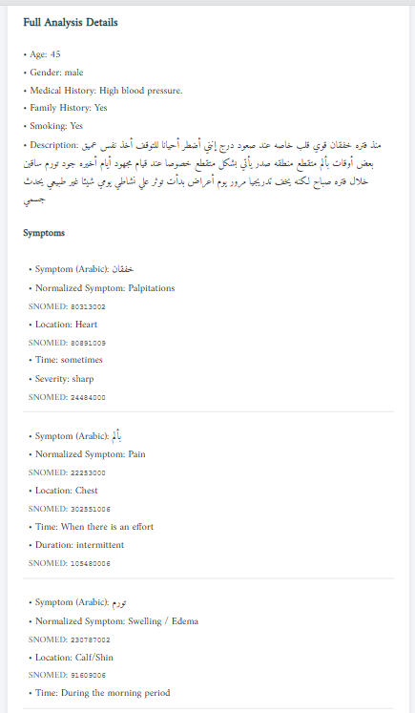
Results
Arabic sample
English sample

Slide 30
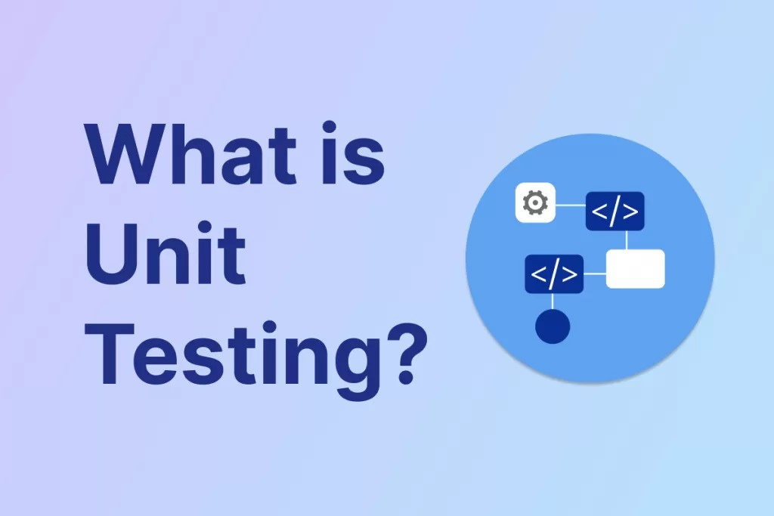
Expanding Data Collection
Future Work
Extending Disease Coverage
Multimodal Data Integration
Enhancing Risk Assessment and Preventive Care
Enhancing Support for Rare
Diseases

Slide 31
Limitations
Data Collection Challenges
Resource Scarcity
Privacy concerns limit access to real-world medical data, impacting dataset diversity.
Arabic lacks robust datasets and NLP tools, making model development more difficult.
Coverage for Rare Diseases
AI-Generated Data Accuracy
Limited data for rare diseases reduces diagnostic accuracy for uncommon conditions.
Synthetic dialogues may lack real-world nuances, introducing potential biases.

Slide 32

Conclusion
This project not only tackled a technical challenge, but also contributed valuable tools and data to the Arabic medical AI ecosystem. It lays the foundation for future expansion into other diseases and modalities

Slide 33

QUASTIONS !

Slide 34

THANK YOU!

